Slide 1

Minimum Spanning Tree Prims and Kruskal Algorithm
Design and Analysis of
Algorithms
Rajesh Kumar Tripathi
Assistant Professor, GLA University, Mathura

Slide 2
Introduction
A graph G(V, E) consists of two sets
a finite, nonempty set of vertices V(G) (points or vertices)
a set of edges E, pair of nodes [u, v] in V, denoted by e=[u, v].
e
u
v

Slide 3
Introduction…
u and v are called endpoints of e, and also said to be adjacent or neighbors.
degree(u) is no. of edges containing u.
degree(u)=0 means if u does not belong to any edge (isolated
node)
e
A path P of length n from node u to v is defined as a sequence of n+1 nodes.
P(v₀, v₁, v₂,……..v_{n})
u=v₀ ; v_{i-1} is adjacent to v_{i} for i=1, 2, 3……., n and v_{n}=v
u
v

Slide 4
Introduction…
A cycle is closed simple path with length 3 or more. A cycle of length k is called k-cycle.
A graph G is said to be connected if there is a path between any two of nodes.
There are 2 simple paths of length 2 from B to E-(B, A, E) & (B, C, E).
There is only 1 simple path of length 2 from B to D- (B, C, D).
2 4-cycles in the graph: [A, B, C, E, A] & [A, C, D, E, A]
Deg(A)=3, Deg(C ) = 4, Deg(D)=2.
A
E
B
C
D

Slide 5
Introduction…
A graph G is said to be complete, if every node u in G is adjacent to every other node v in G.
A complete graph G of n nodes has n*(n-1)/2 edges.
A
E
B
C
D

Slide 6
Introduction…
A connected graph without any cycles is called a tree graph
If tree T is finite with m nodes, then T will have m-1 edges.
A
B
C
D
E
F

Slide 7
Introduction…
A graph G is said to be labeled or weighted if its edges are assigned data. .
5
2
A
E
B
4
7
3
1
C
D
2

Slide 8
Introduction…
A Multiple edges. connects the same endpoints (e4 and e5 connects C and D),
An edge is called Loop if it has identical endpoints i.e. e6 connects (D, D)
e1
A
E
e6
e2
e3
C
D
e5
e4

Slide 9
Introduction…
A Directed Graph G, also called a digraph or graph in which each edge is assigned a direction.
Suppose G is directed graph with directed edge e=(u, v).
e begins at u and ends at v.
u is origin and v is destination.
u is predecessor of v and v is successor of u.
u is adjacent to v.
A
E
C
D

Slide 10
Introduction…
A Directed Graph G, is said to be connected or strongly connected, if for each pair there is a path from u to v and v to u.
⁇
A Directed Graph G, is said to be unilaterally connected if for any pair u, v of nodes in G there is a path from u to v or a path from v to u.
A
E
C
D

Slide 11
Introduction…
Degree
3
0
0
2
1
2
3
1
2
3
3
3
3
4
5
6
3
3
1
G1
1
G2
1
1
0
in:1, out: 1
directed graph
in-degree
out-degree
1
in: 1, out: 2
G3
2
in: 1, out: 0

Slide 12
Graph Representation of Graphs…
Sequential Representation
Adjacency matrix
Path Matrix
Linked List Representation

Slide 13
Graph Representation of Graphs…
Sequential Representation
Adjacency matrix: Adjacency matrix representation of a graph G consists of V x V matrix A=( a_{ij} ) such that

Slide 14
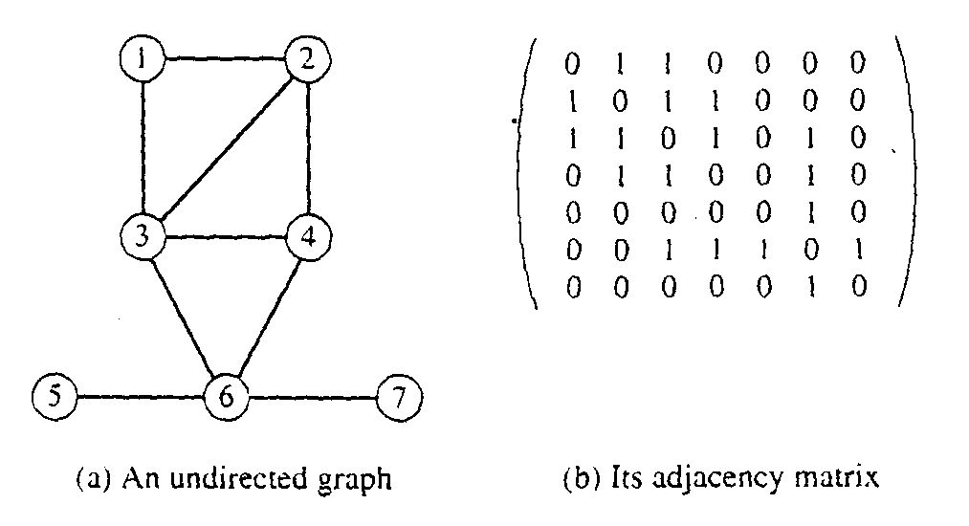
Graph Representation of Graphs…

Slide 15
Graph Representation of Graphs…
Adjacency matrix:
0
1
2
3

Slide 16
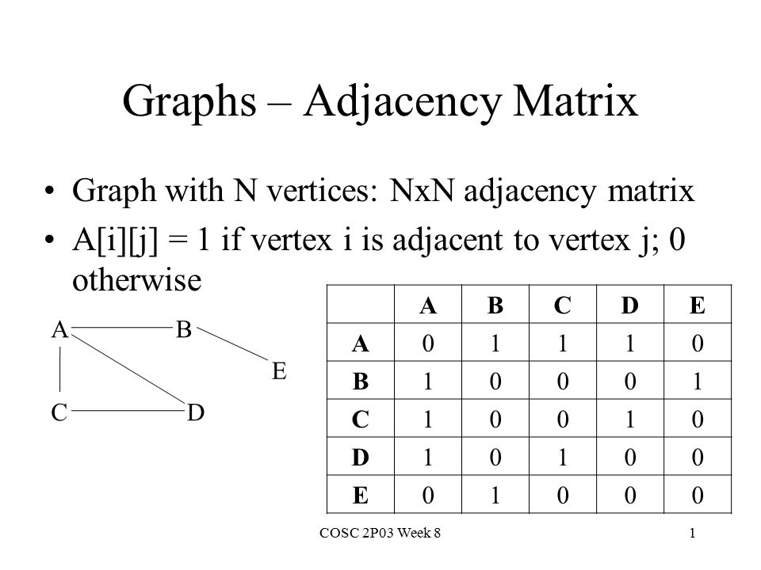

Slide 17
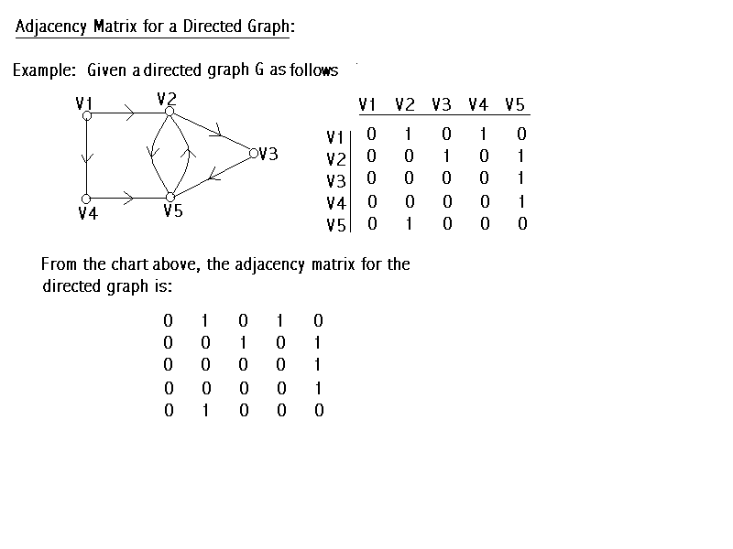

Slide 18
Graph Representation of Graphs…
Sequential Representation
Path matrix: Adjacency matrix representation of a directed graph G consists of m nodes then P= (p_{ij})

Slide 19
Graph Representation of Graphs…
Path matrix:
0
1
2

Slide 20
Graph Representation of Graphs…
Sequential Representation
Linked List Representation

Slide 21
0
0
4
2
1
5
1
2
3
6
3
7
0
1
2
3
1
2
3
0
1
2
3
4
5
6
7
1
2
0
2
3
0
3
0
1
3
0
3
0
1
2
1
2
G1
0
5
4
6
0
1
2
1
5
7
0
2
1
6
G₂
G4
2

Slide 22
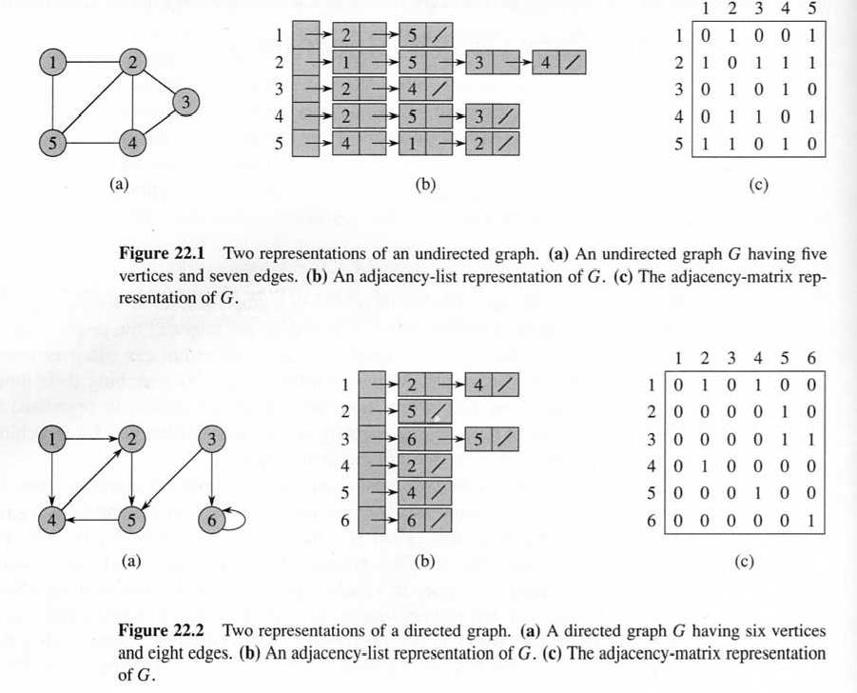

Slide 23
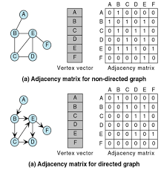

Slide 24
Graph Traversal
Systematic search of vertex and edges of a graph.
Graph G(V, E) is either directed or undirected.
BFS (Breadth First Search)
DFS (Depth First Search)

Slide 25
Graph Traversal
BFS (Breadth First Search)
BFS starts at vertex s which is at level 0.
In the first step, we visit all vertices that are at distance 1 edge away, when we visit there we paint as “visited” , the vertices adjacent to the start vertex s-these vertices are placed into level 1.
In second step, visit all new vertices, we can reach at the distance of two edges away from the source vertex s. These new vertices, which are adjacent to level 1 vertices and not previously assigned to a level, are placed into level 2 and so on.
The BFS traversal terminates when every vertex has been visited.

Slide 26
Graph Traversal
Algorithm maintains a queue Q to manage set of vertices and start with s, source vertex
Initially , all vertices except s are colored white, and s is gray.
BFS algorithm maintains the following information for each vertex u:
color[u] (white, gray and black): indicates status
white: not discovered yet
gray: discovered but not finished
black: finished
d[u]: distance from s to u
ᴨ(u): predecessor of u

Slide 27
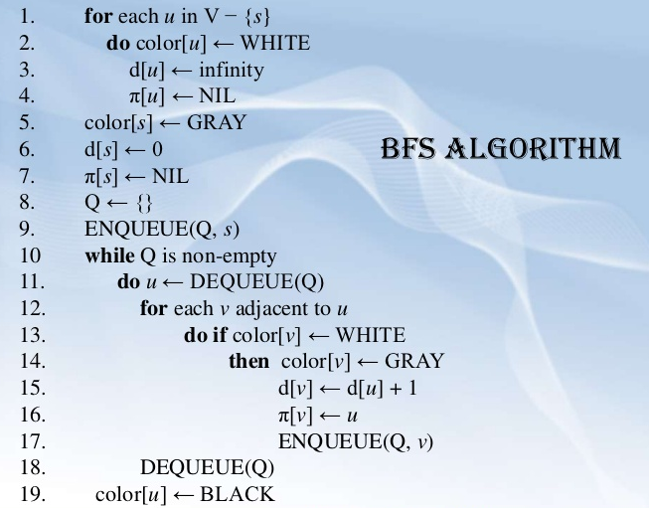
Graph Traversal

Slide 28
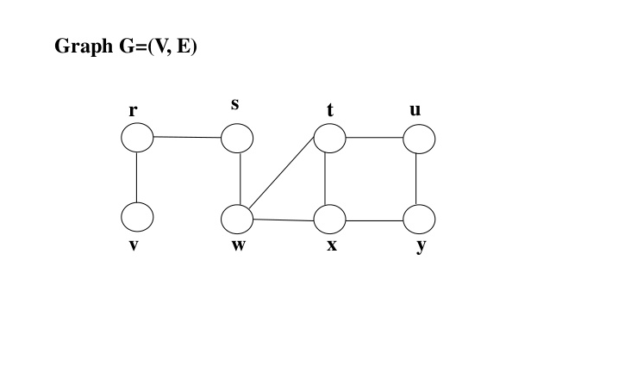
Graph Traversal

Slide 29
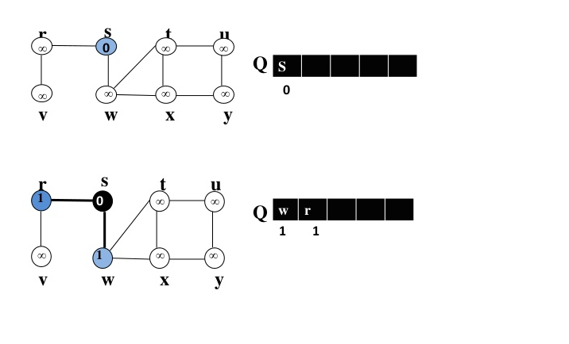
Graph Traversal

Slide 30
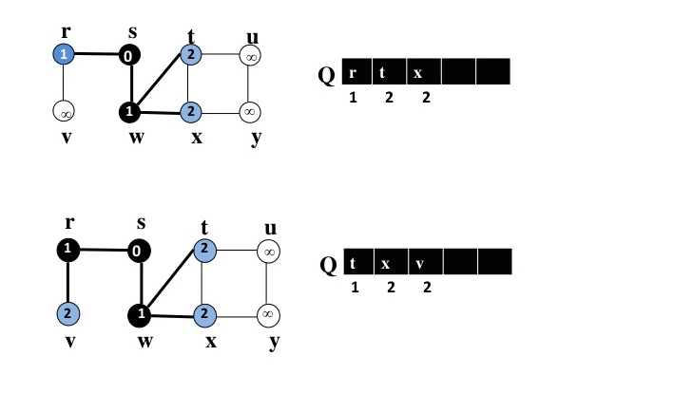
Graph Traversal

Slide 31
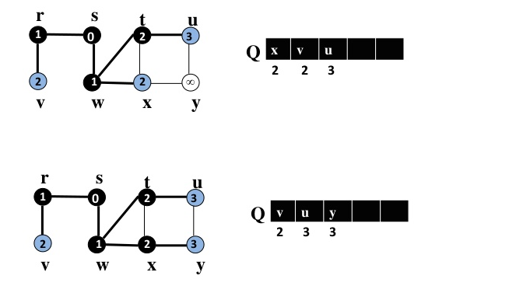
Graph Traversal

Slide 32
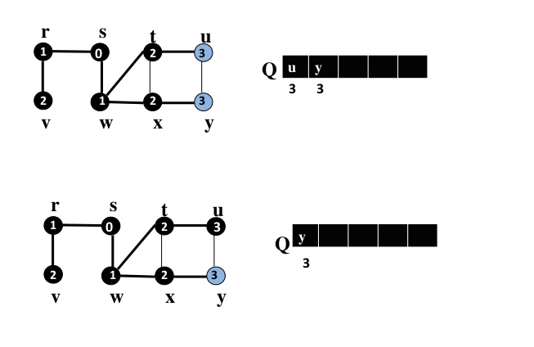
Graph Traversal

Slide 33
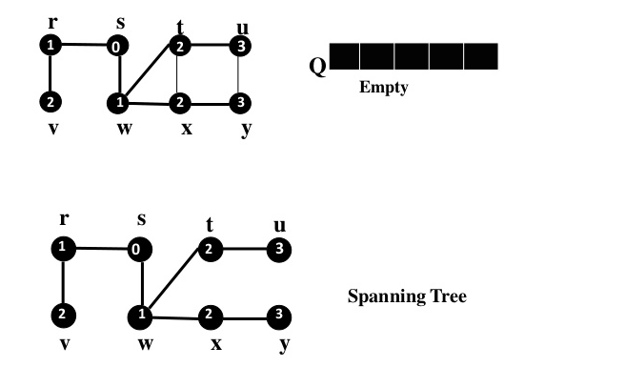
Graph Traversal
Running time= O(V+E)

Slide 34
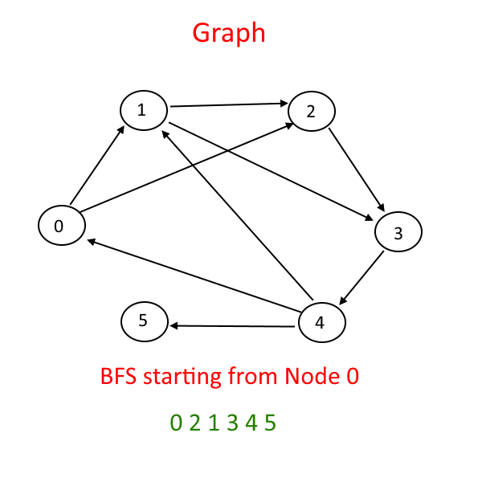

Slide 36
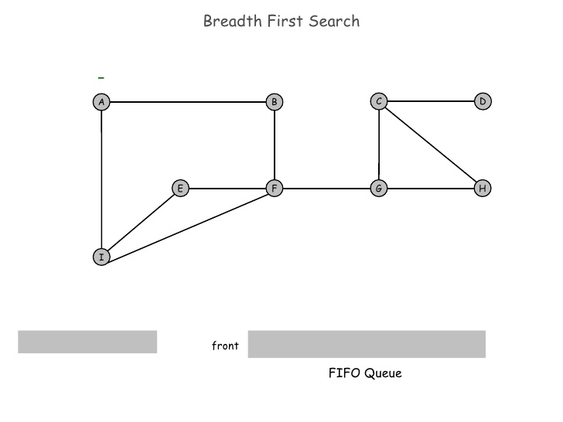
Graph Traversal

Slide 37
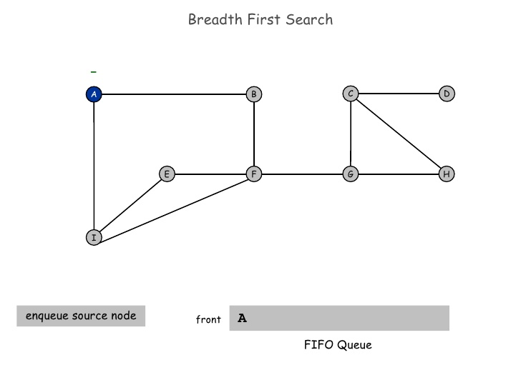
Graph Traversal

Slide 38
Graph Traversal

Slide 39

Graph Traversal

Slide 40
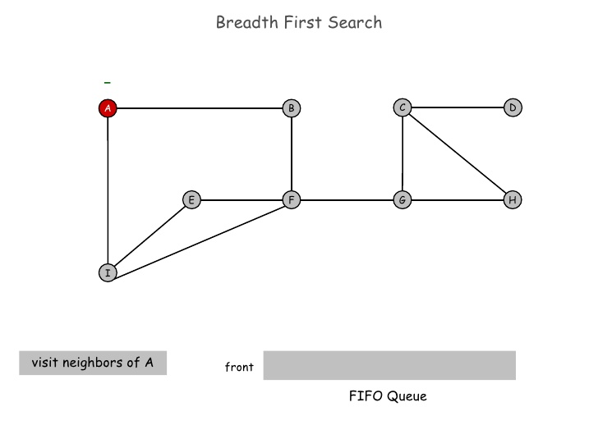
Graph Traversal

Slide 41
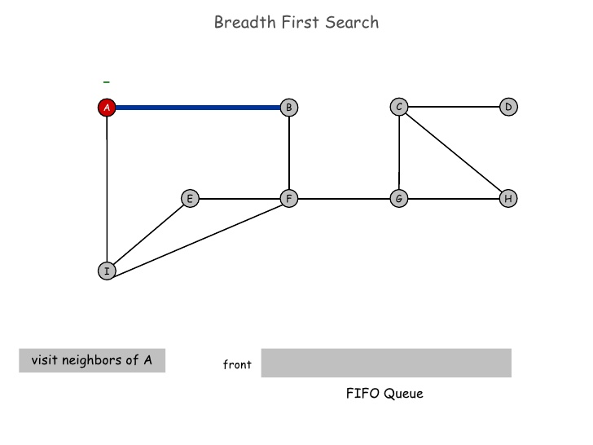
Graph Traversal

Slide 42
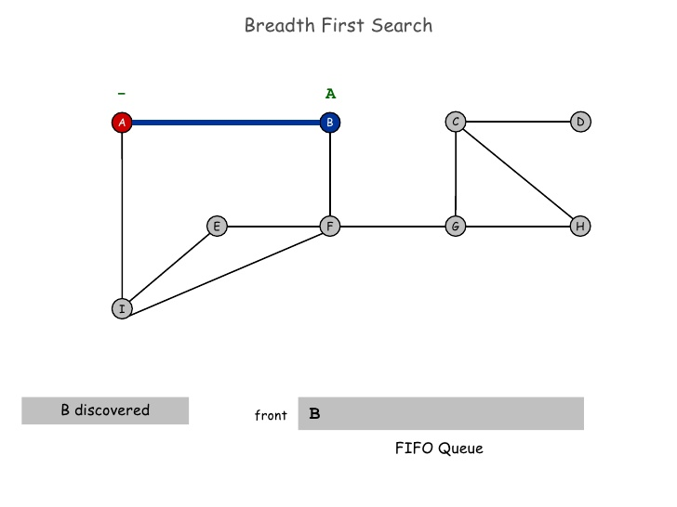
Graph Traversal

Slide 43
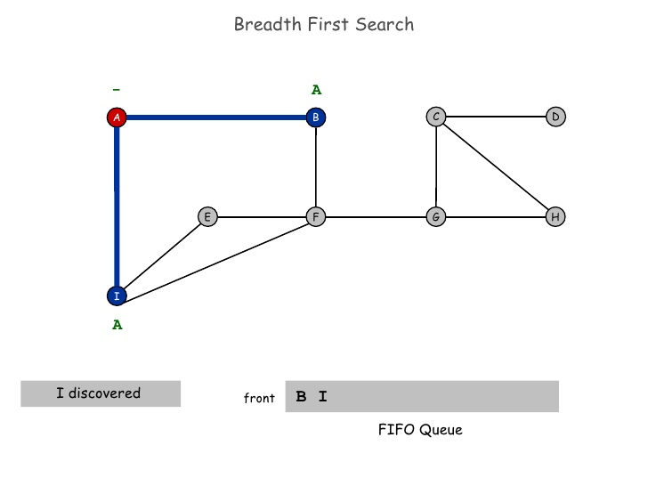
Graph Traversal

Slide 44
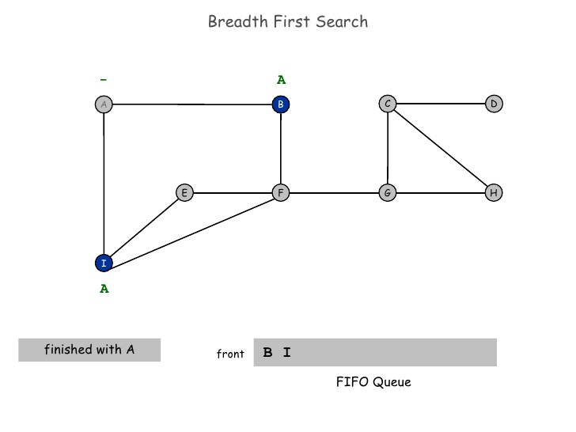
Graph Traversal

Slide 45
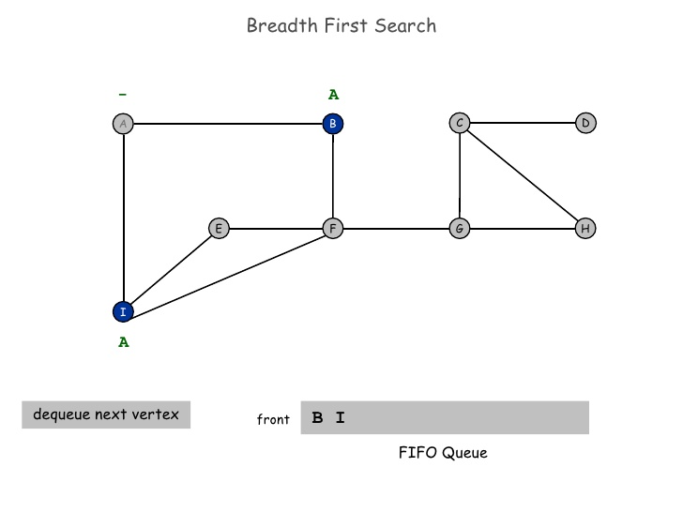
Graph Traversal

Slide 46
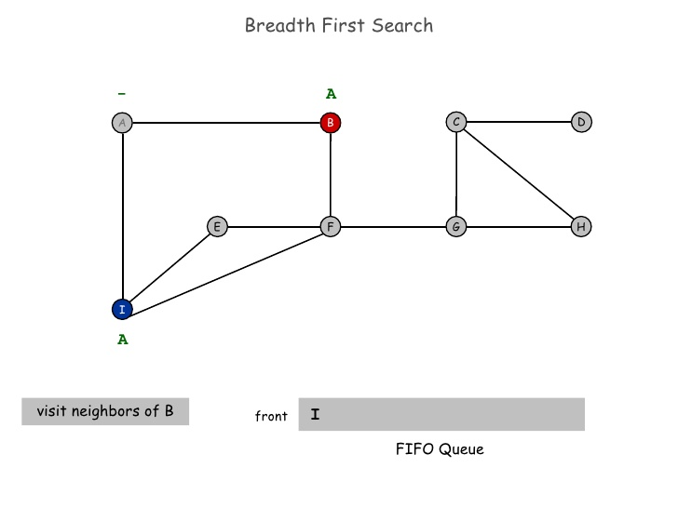
Graph Traversal

Slide 47
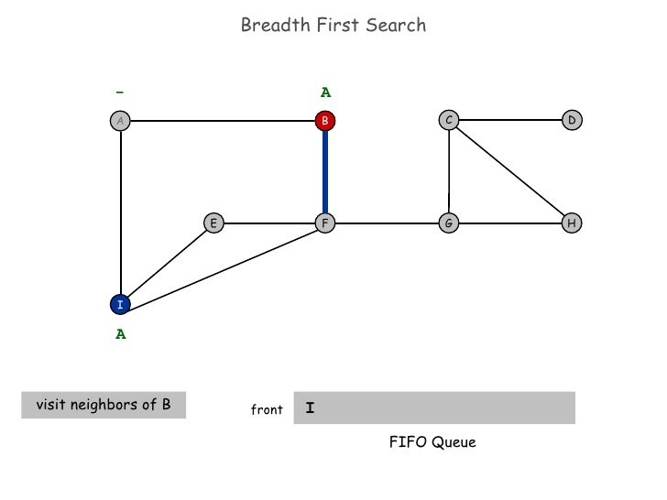
Graph Traversal

Slide 48
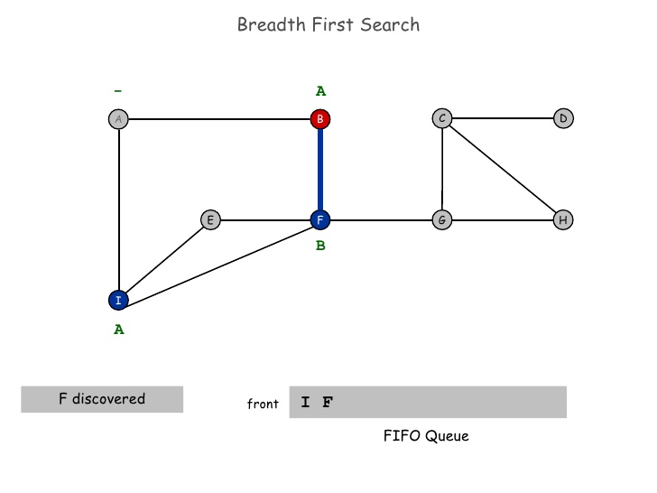
Graph Traversal

Slide 49
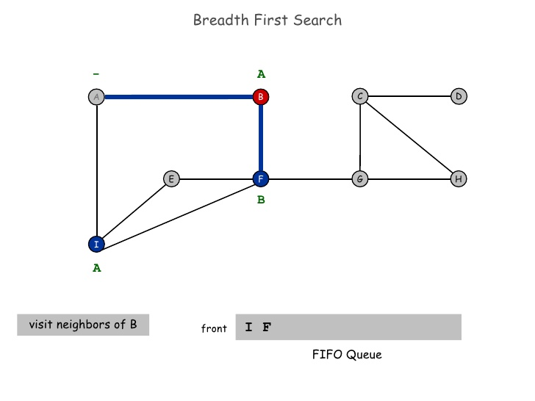
Graph Traversal

Slide 50

Graph Traversal

Slide 51
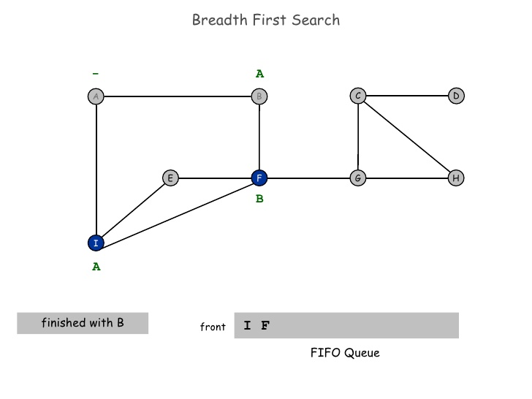
Graph Traversal

Slide 52
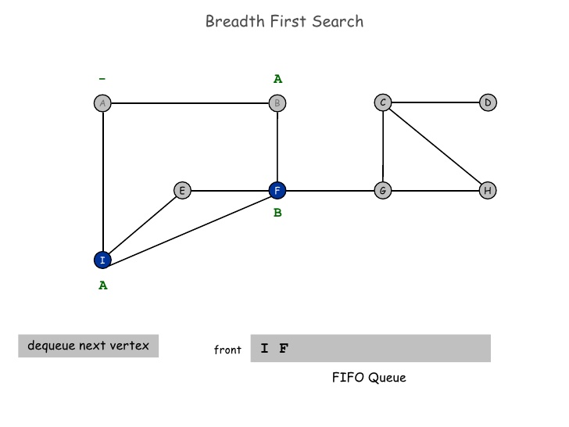
Graph Traversal

Slide 53
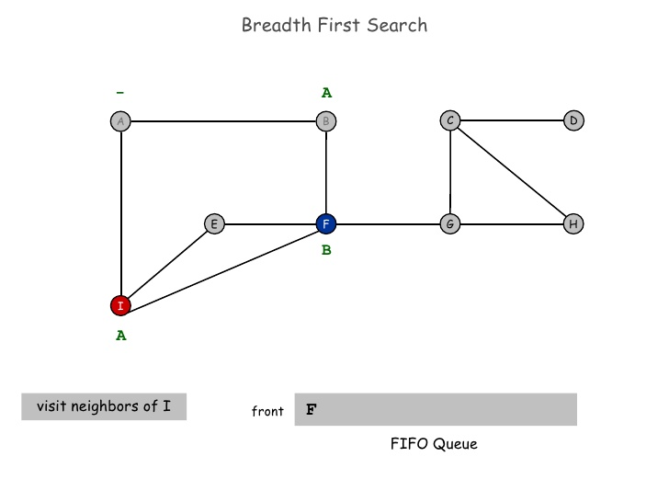
Graph Traversal

Slide 54
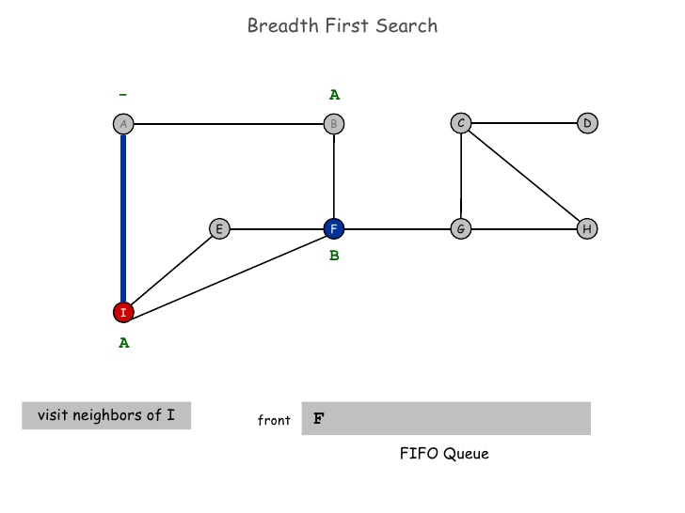
Graph Traversal

Slide 55

Graph Traversal

Slide 56
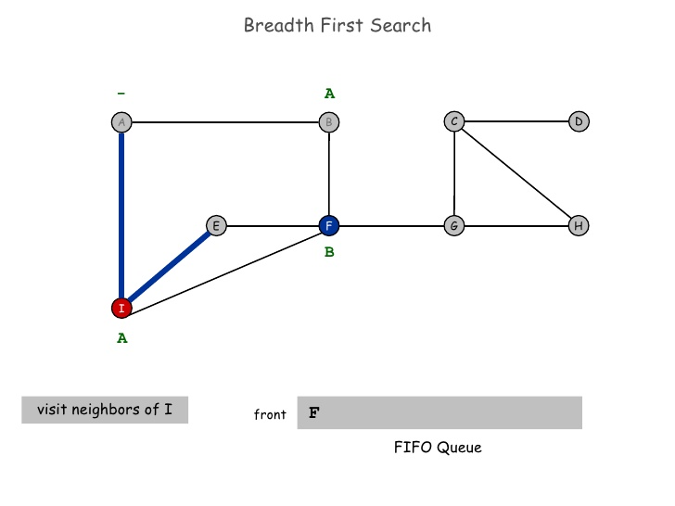
Graph Traversal

Slide 57
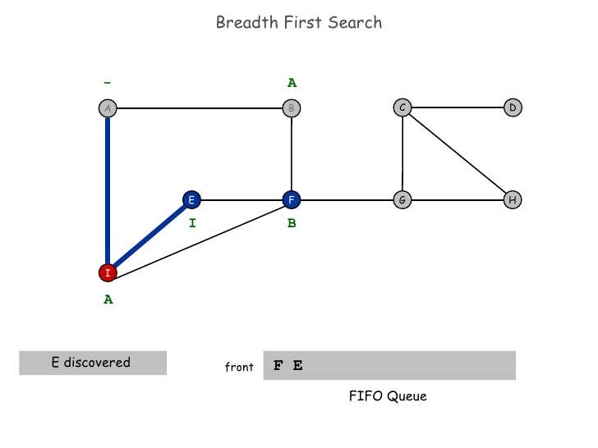
Graph Traversal

Slide 58
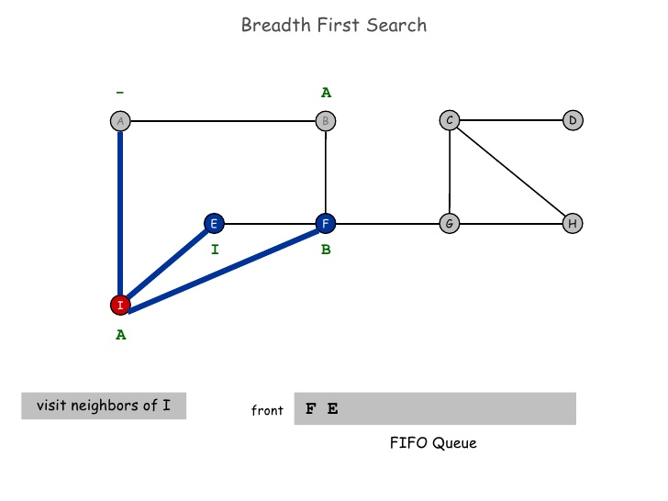
Graph Traversal

Slide 59
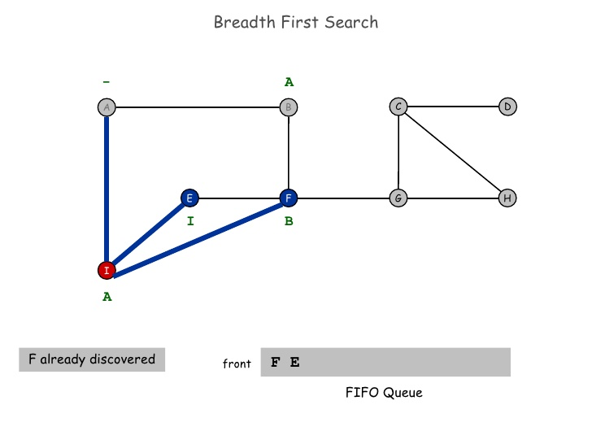
Graph Traversal

Slide 60
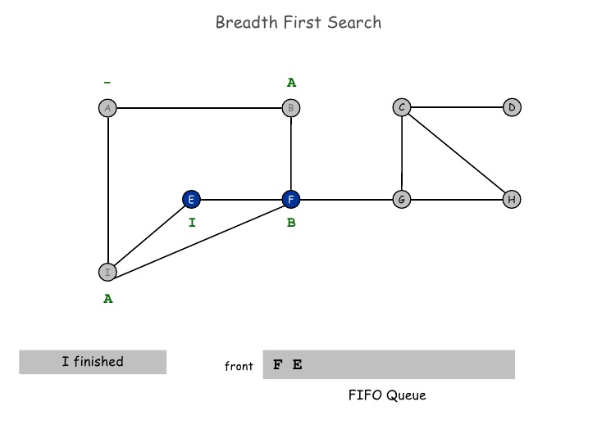
Graph Traversal

Slide 61
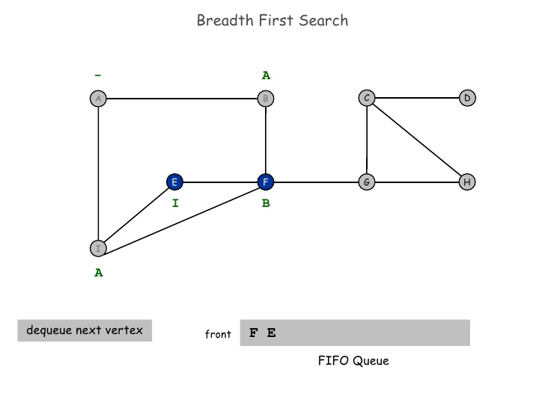
Graph Traversal

Slide 62
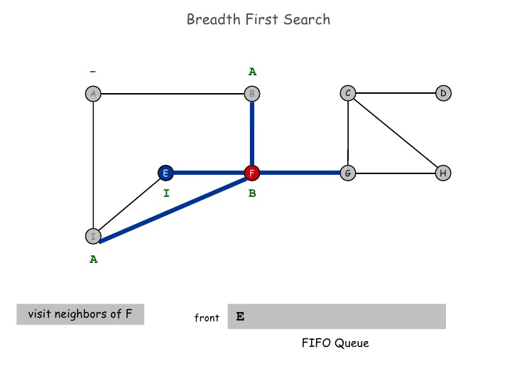
Graph Traversal

Slide 63
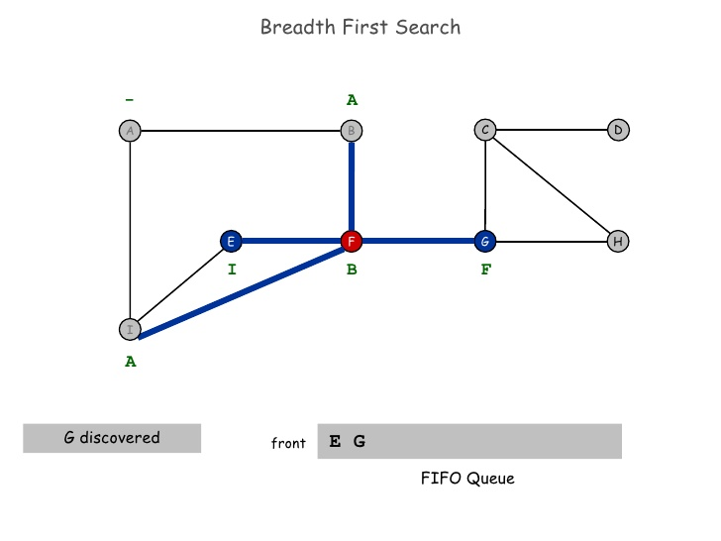
Graph Traversal

Slide 64
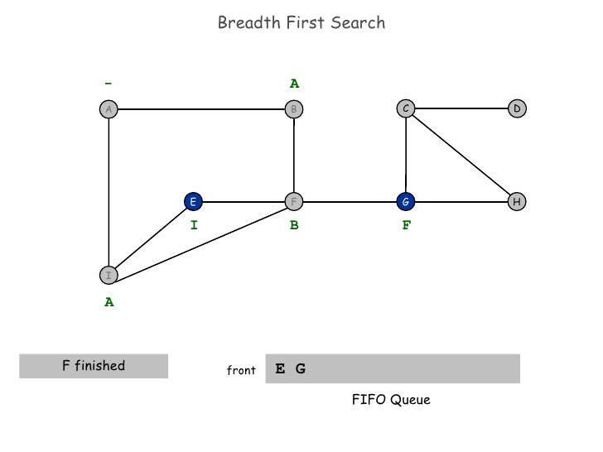
Graph Traversal

Slide 65
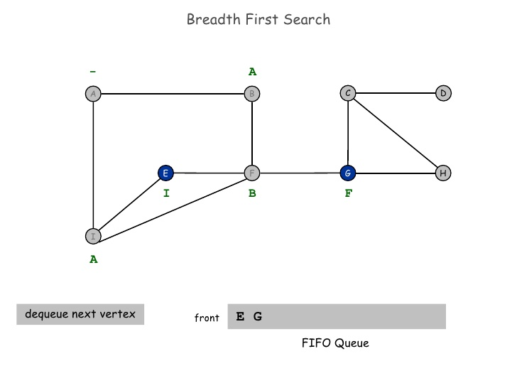
Graph Traversal

Slide 66
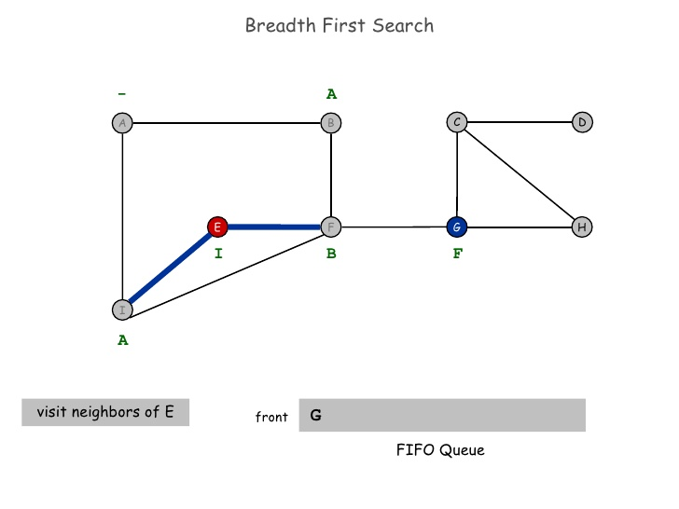
Graph Traversal

Slide 67
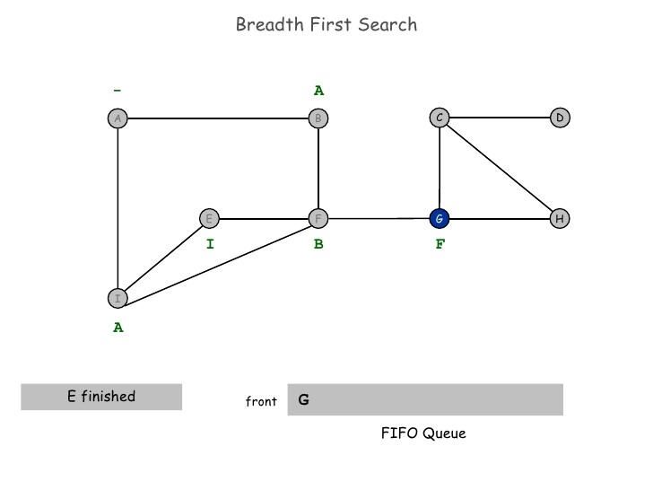
Graph Traversal

Slide 68
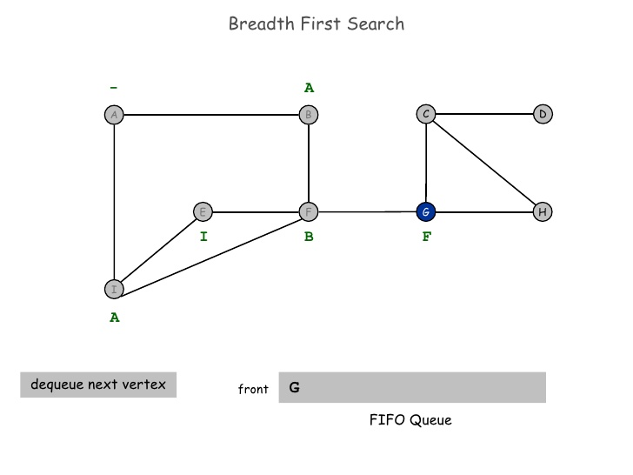
Graph Traversal

Slide 69
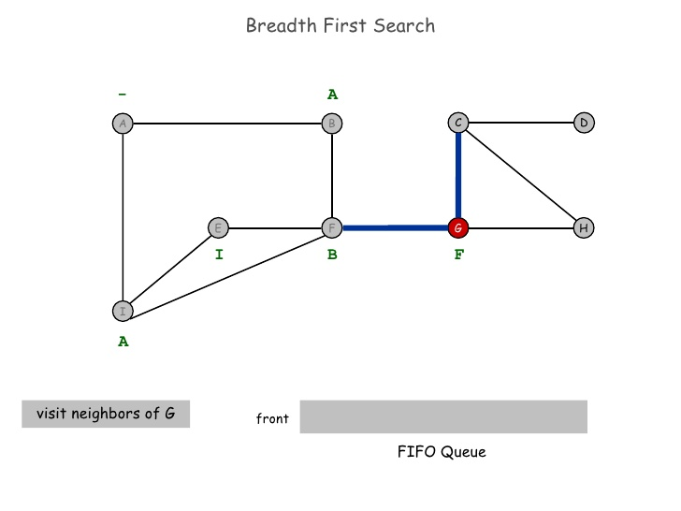
Graph Traversal

Slide 70
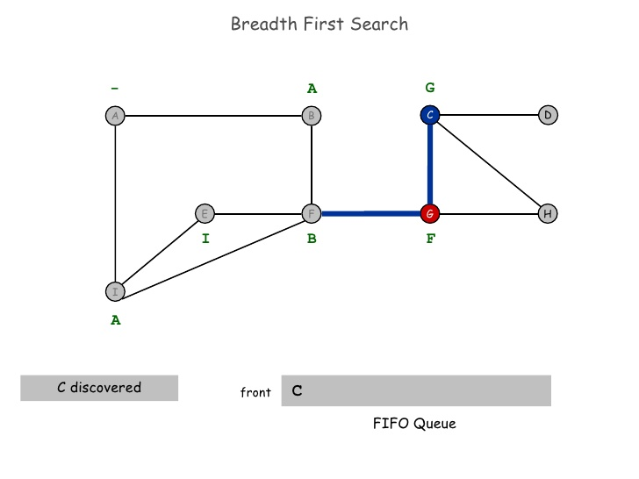
Graph Traversal

Slide 71
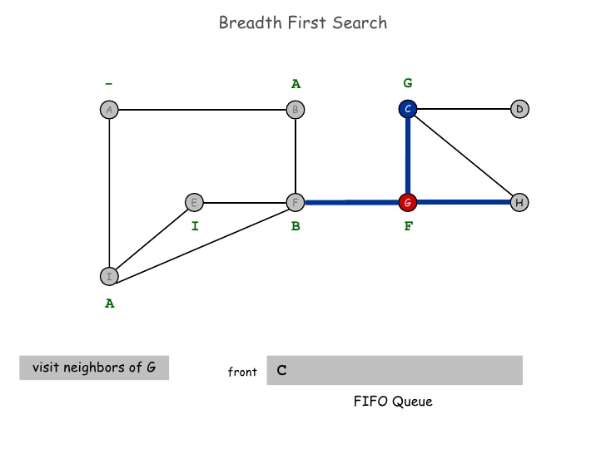
Graph Traversal

Slide 72
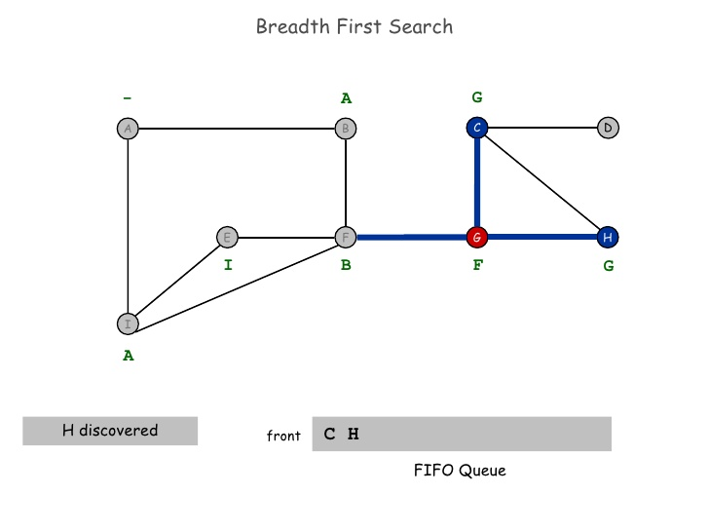
Graph Traversal

Slide 73
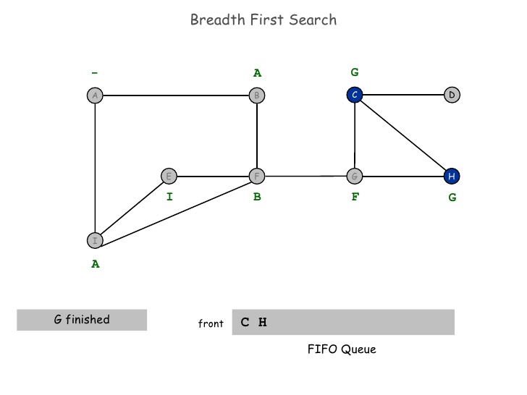
Graph Traversal

Slide 74

Graph Traversal

Slide 75
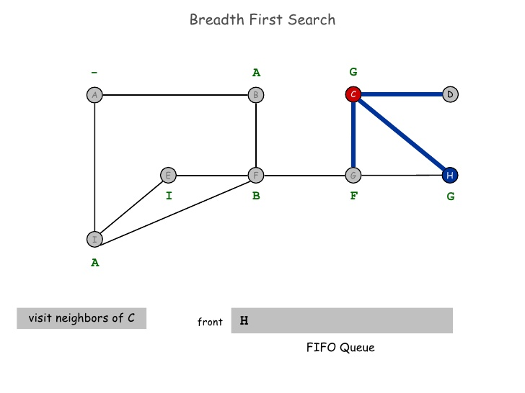
Graph Traversal

Slide 76
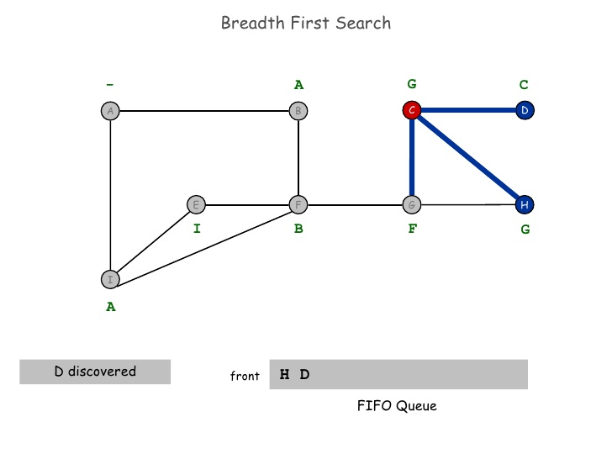
Graph Traversal

Slide 77
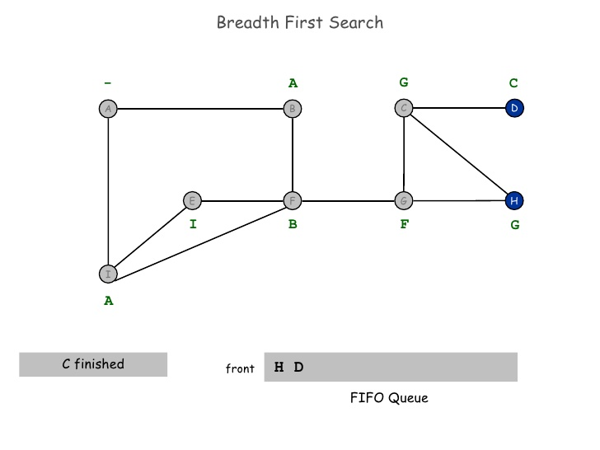
Graph Traversal

Slide 78

Graph Traversal

Slide 79

Graph Traversal

Slide 80

Graph Traversal

Slide 81

Graph Traversal

Slide 82

Graph Traversal

Slide 83

Graph Traversal

Slide 84

Graph Traversal

Slide 85

Graph Traversal

Slide 86
Graph Traversal
DFS (Depth First Search)
DFS(G)
for each vertex u ∈ G->V
do color[u] = WHITE;
ᴨ[u]=Nil
time = 0;
for each vertex u ∈ G->V
do if color[u] == WHITE
DFS_Visit(u);
DFS_Visit(u)
color[u] = GREY;
time = time+1;
d[u] = time;
for each v ∈ u->Adj[]
if color[v] == WHITE
DFS_Visit(v);
color[u] = BLACK;
time = time+1;
f[u] = time;

Slide 87
Graph Traversal
DFS (Depth First Search)
source vertex

Slide 88
Graph Traversal
DFS (Depth First Search)
source vertex
d f
1 |
|
|
|
|
|
|
|

Slide 89
Graph Traversal
DFS (Depth First Search)
source vertex
1 |
|
|
2 |
|
|
|
|

Slide 90
Graph Traversal
DFS (Depth First Search)
source vertex
d f
1 |
|
|
2 |
|
3 |
|
|

Slide 91
Graph Traversal
DFS (Depth First Search)
source vertex
1 |
|
|
2 |
|
3 | 4
|
|

Slide 92
Graph Traversal
DFS (Depth First Search)
source vertex
1 |
|
|
2 |
|
3 | 4
5 |
|

Slide 93
Graph Traversal
DFS (Depth First Search)
source vertex
1 |
|
|
2 |
|
3 | 4
5 | 6
|

Slide 94
Graph Traversal
DFS (Depth First Search)
source vertex
1 |
8 |
|
2 | 7
|
3 | 4
5 | 6
|

Slide 95
Graph Traversal
DFS (Depth First Search)
source vertex
1 |
8 |
|
2 | 7
9 |
3 | 4
5 | 6
|

Slide 96
Graph Traversal
DFS (Depth First Search)
source vertex
1 |
8 |
|
2 | 7
9 |10
3 | 4
5 | 6
|

Slide 97
Graph Traversal
DFS (Depth First Search)
source vertex
1 |
8 |11
|
2 | 7
9 |10
3 | 4
5 | 6
|

Slide 98
Graph Traversal
DFS (Depth First Search)
source vertex
1 |12
8 |11
|
2 | 7
9 |10
3 | 4
5 | 6
|

Slide 99
Graph Traversal
DFS (Depth First Search)
source vertex
1 |12
8 |11
13|
2 | 7
9 |10
3 | 4
5 | 6
|

Slide 100
Graph Traversal
DFS (Depth First Search)
source vertex
1 |12
8 |11
13|
2 | 7
9 |10
3 | 4
5 | 6
14|

Slide 101
Graph Traversal
DFS (Depth First Search)
source vertex
1 |12
8 |11
13|
2 | 7
9 |10
3 | 4
5 | 6
14|15

Slide 102
Graph Traversal
DFS (Depth First Search)
source vertex
1 |12
8 |11
13|16
2 | 7
9 |10
3 | 4
5 | 6
14|15

Slide 103
Minimum Spanning Tree Prims and Kruskal Algorithm
Design and Analysis of
Algorithms
Rajesh Kumar Tripathi
Assistant Professor, GLA University, Mathura

Slide 104
Minimum Cost Spanning Tree
Electronic circuit design
Network design

Slide 105
Minimum Cost Spanning Tree
Kruskal’s Algorithm
MST-KRUSKAL(G,w)
A=ᵩ
for each vertex vϵG.V
MAKE-SET(V)
sort the edges of G,E into non-decreasing order by weight w
for each edge (u, v) ϵ G,E, taken in nondecreasing order by weight
if FIND-SET(u)!=FIND-SET(v)
A =A U {u,v}
UNION(u,v)
return A

Slide 106

Minimum Cost Spanning Tree
Kruskal’s Algorithm

Slide 107

Minimum Cost Spanning Tree
Kruskal’s Algorithm :
Remove loops and parallel edges (save minimum weight edge)

Slide 108

Minimum Cost Spanning Tree
Kruskal’s Algorithm :

Slide 109

Minimum Cost Spanning Tree
Kruskal’s Algorithm : Add the edge which has least weight

Slide 110

Minimum Cost Spanning Tree
Kruskal’s Algorithm : Add the edge which has least weight

Slide 111

Minimum Cost Spanning Tree
Kruskal’s Algorithm : Add the edge which has least weight

Slide 112

Minimum Cost Spanning Tree
Kruskal’s Algorithm : Add the edge which has least weight

Slide 113

Minimum Cost Spanning Tree
Kruskal’s Algorithm : Add the edge which has least weight

Slide 114

Minimum Cost Spanning Tree
Kruskal’s Algorithm : Add the edge which has least weight

Slide 115
Minimum Cost Spanning Tree
Kruskal’s Algorithm : Add the edge which has least weight
Complexity of the Kruskal-O(E logV)

Slide 116

Minimum Cost Spanning Tree
Prim’s Algorithm :

Slide 117

Minimum Cost Spanning Tree
Prim’s Algorithm :

Slide 118

Minimum Cost Spanning Tree
Prim’s Algorithm :

Slide 119

Minimum Cost Spanning Tree
Prim’s Algorithm :

Slide 120

Minimum Cost Spanning Tree
Prim’s Algorithm :

Slide 121

Minimum Cost Spanning Tree
Prim’s Algorithm :

Slide 122

Minimum Cost Spanning Tree
Prim’s Algorithm :

Slide 123

Minimum Cost Spanning Tree
Prim’s Algorithm :

Slide 124

Minimum Cost Spanning Tree
Prim’s Algorithm :

Slide 125

Minimum Cost Spanning Tree
Prim’s Algorithm :

Slide 126
Minimum Cost Spanning Tree
Prim’s Algorithm :

Slide 127
Minimum Cost Spanning Tree
Prim’s Algorithm :
Remove loops and more than one edges

Slide 128
Minimum Cost Spanning Tree
Prim’s Algorithm :
Remove loops and more than one edges

Slide 129

Minimum Cost Spanning Tree
Prim’s Algorithm :
Select source node

Slide 130

Minimum Cost Spanning Tree
Prim’s Algorithm :
Select source node

Slide 131

Minimum Cost Spanning Tree
Prim’s Algorithm :
Select source node

Slide 132

Minimum Cost Spanning Tree
Prim’s Algorithm :
Select source node

Slide 133

Minimum Cost Spanning Tree
Kruskal Algorithm :

Slide 134

Minimum Cost Spanning Tree
Kruskal Algorithm :

Slide 135

Minimum Cost Spanning Tree
Kruskal Algorithm :

Slide 136

Minimum Cost Spanning Tree
Kruskal Algorithm :

Slide 137

Minimum Cost Spanning Tree
Kruskal Algorithm :

Slide 138

Minimum Cost Spanning Tree
Kruskal Algorithm :

Slide 139

Minimum Cost Spanning Tree
Kruskal Algorithm :

Slide 140

Minimum Cost Spanning Tree
Kruskal Algorithm :

Slide 141

Minimum Cost Spanning Tree
Kruskal Algorithm :

Slide 142

Minimum Cost Spanning Tree
Kruskal Algorithm :

Slide 143

Minimum Cost Spanning Tree
Kruskal Algorithm :

Slide 144

Minimum Cost Spanning Tree
Kruskal Algorithm :

Slide 145

Minimum Cost Spanning Tree
Kruskal Algorithm :

Slide 146

Minimum Cost Spanning Tree
Kruskal Algorithm :

Slide 147

Shortest path problems
Dijkstra :

Slide 148

Shortest path problems
Dijkstra :

Slide 149

Shortest path problems
Dijkstra :

Slide 150

Shortest path problems
Dijkstra :

Slide 151

Shortest path problems
Dijkstra :

Slide 152

Shortest path problems
Dijkstra :

Slide 153

Shortest path problems
Dijkstra :

Slide 154
Thank You

